Slide 1

GameCo Video Game Sales Analysis
By Margo Shogren
Prepared on 1/18/2023

Slide 2
In this analysis of video game sales, we are testing our assumption:
Have video game sales have remained constant for the timeframe between 1980 -2016 for each major geographic region North America, Europe and Japan?

Slide 3
North American Sales
North American sales have not been constant throughout the years
North American video game sales data shows an upward increase in sales with the peak in 2008. After 2008, the sales start to decrease quite a bit took a downturn through 2016.

Slide 4
What platforms were selling at peak of sales?
At the peak of sales in 2008 , we see there are several major selling platforms which did not sell in 2012.
In 2008, the major platforms sold were Wii, Xbox360, DS and PS3

Slide 5
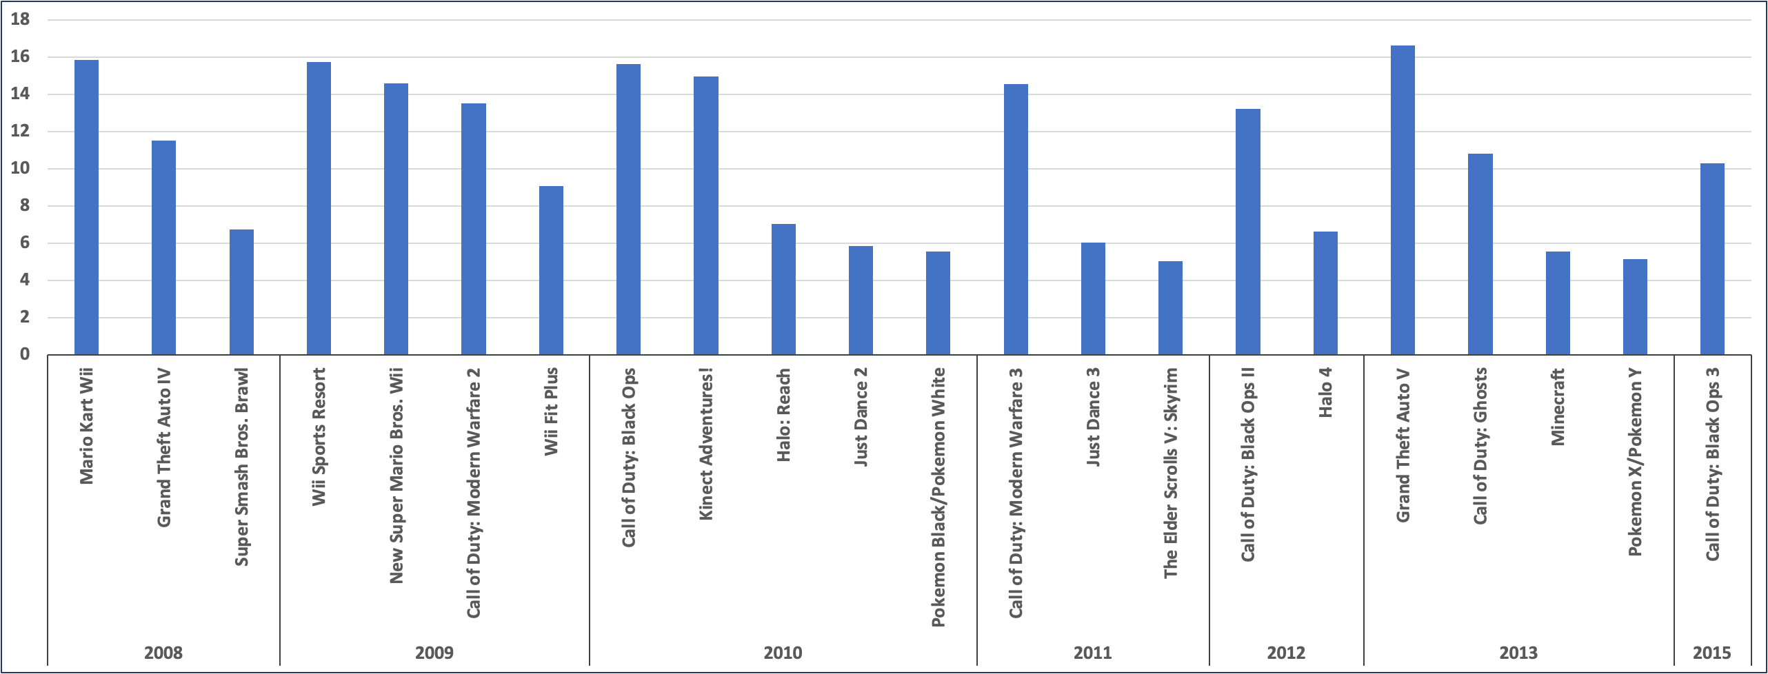
Top selling North American video games by year

Slide 6
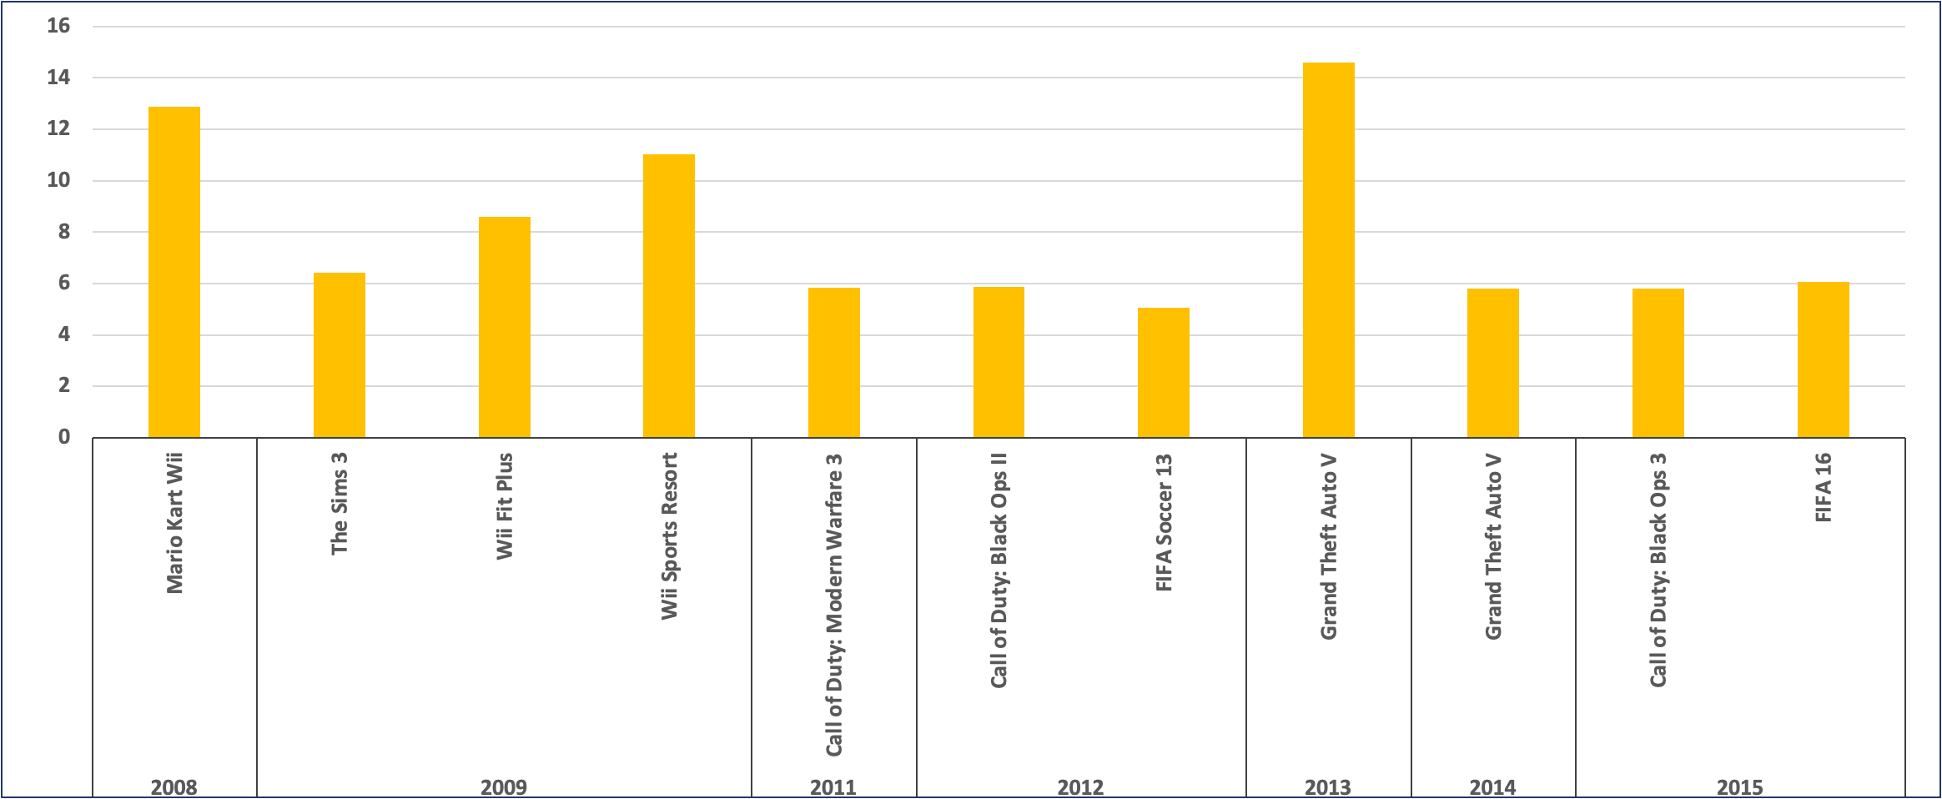
Top selling European video games by year

Slide 7
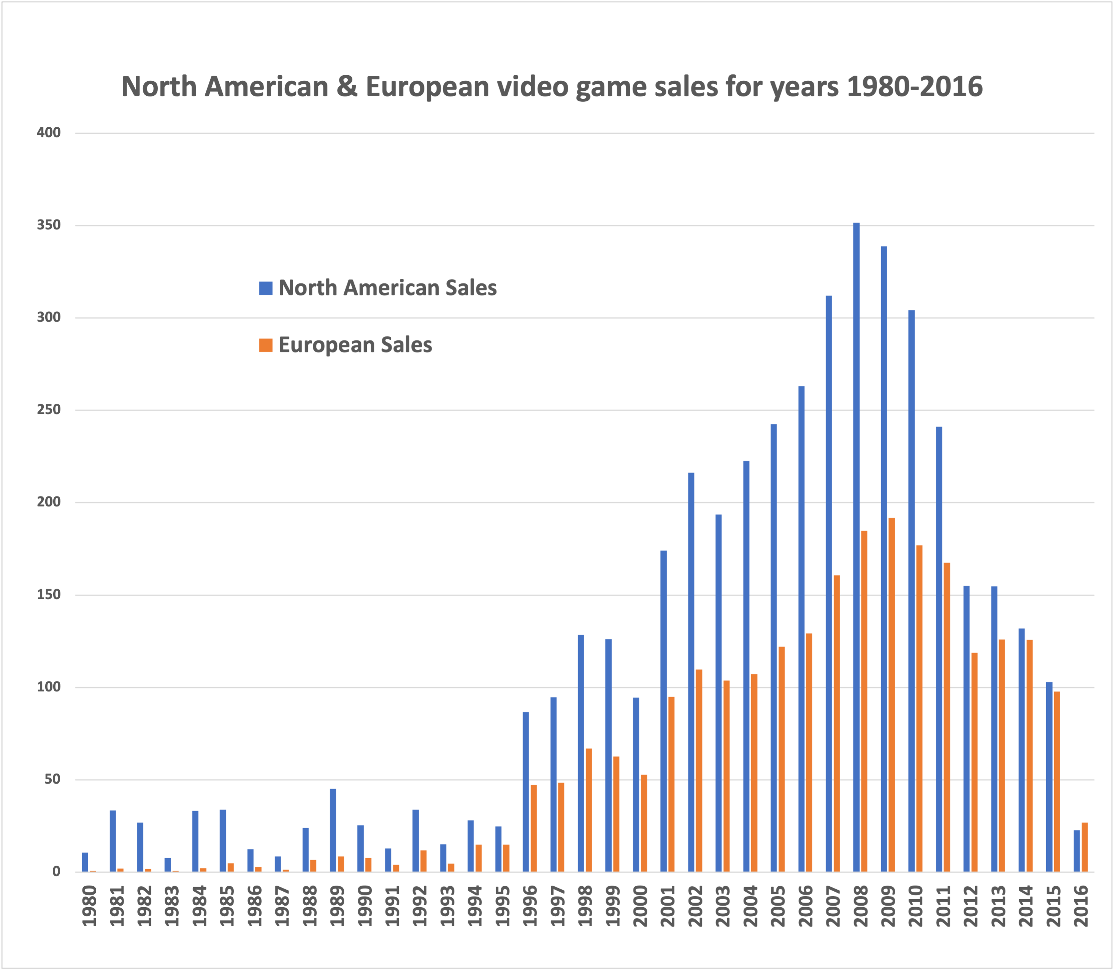

European Sales
For European sales vs. North American
we see that the European sales follows the same trend as North American sales

Slide 8
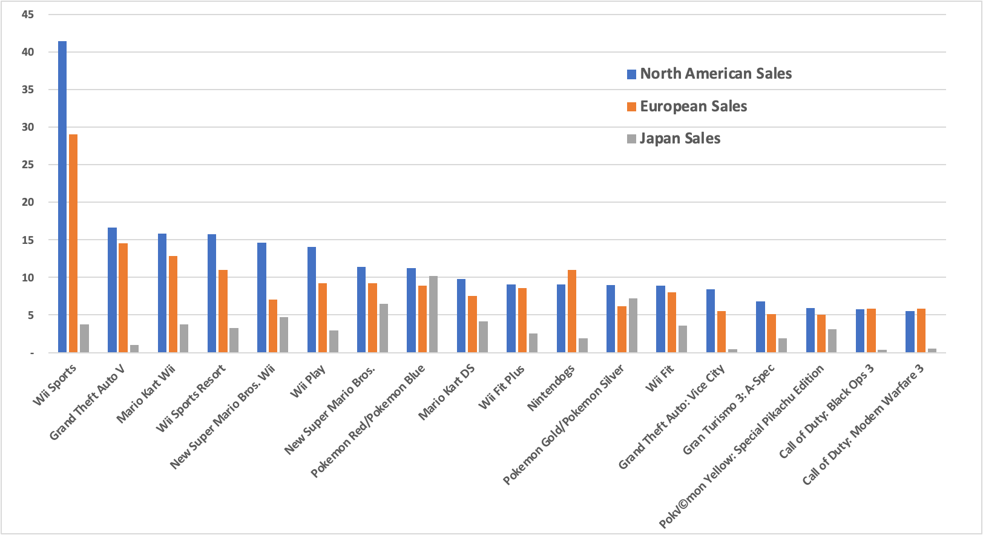
Popular video games by region

Slide 9
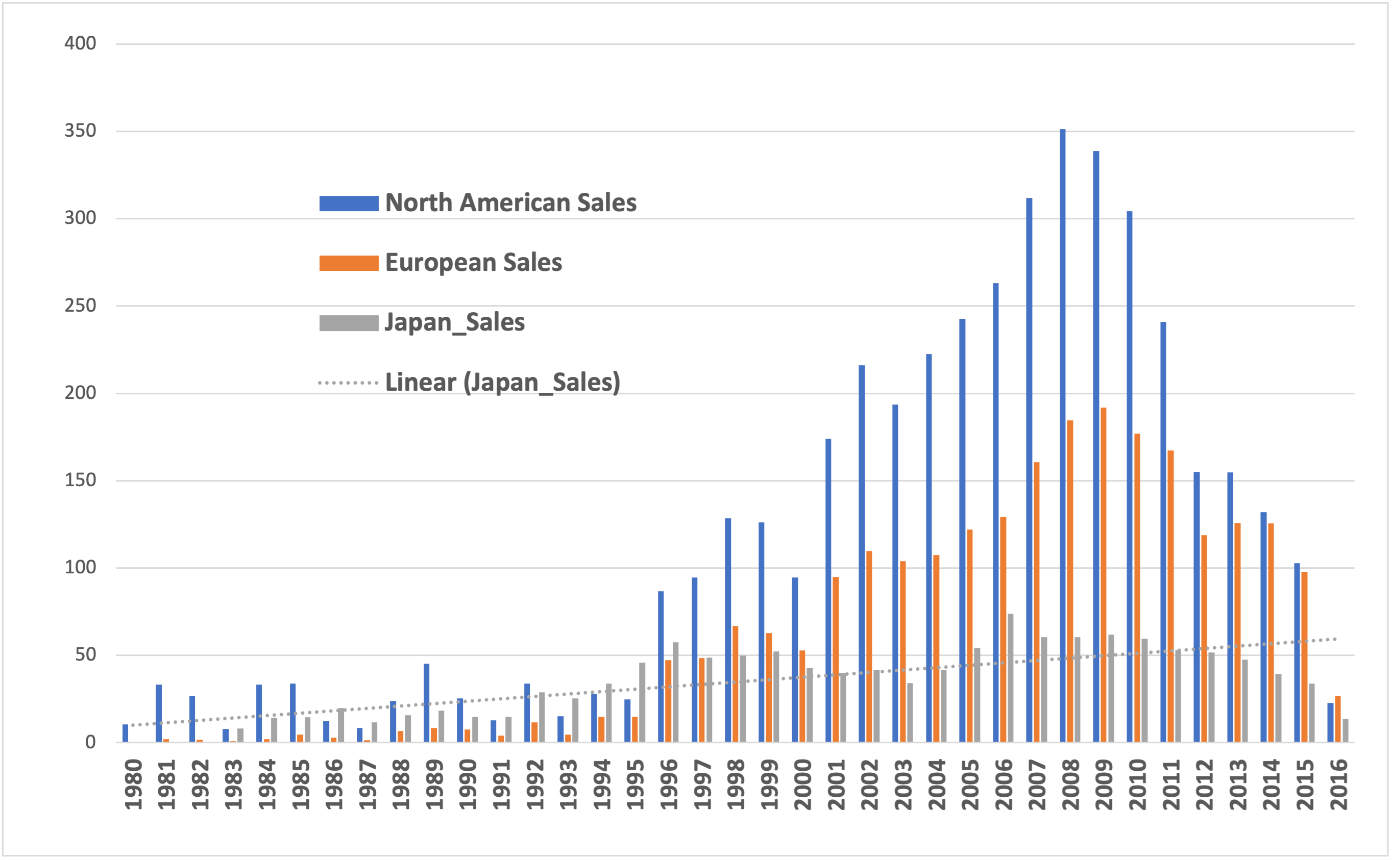
Japan Sales
We can see below on the grey trendline that Japan sales were much lower than North American and European sales but increase slightly in early 2000’s then all decrease.

Slide 10
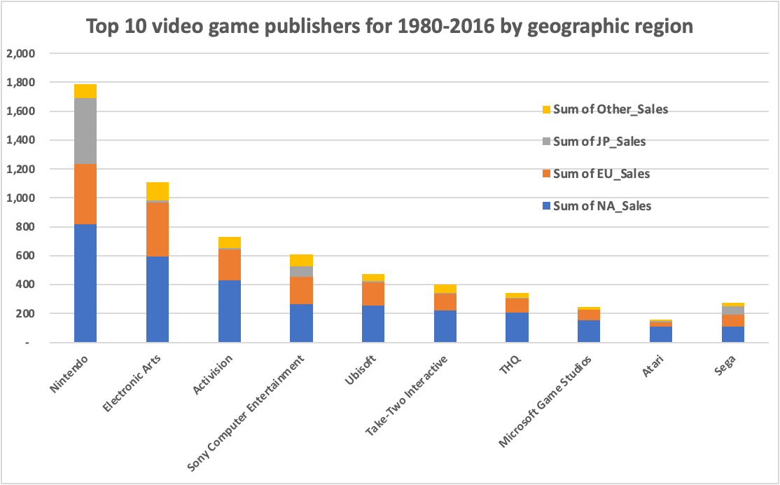
What are the competitive publishers?
We see by this graph that the top selling publishers across all regions by far is Nintendo. These would be the top selling publishers that GameCo will compete against.

Slide 11
Most popular genres of video games by region
We see in this line chart that the top selling genre is:
Action, followed by Sports and Misc.
GameCo can put more budget resources on those top three genres for budgeting

Slide 12
Summary
Video game sales across the regions has not been constant North American and Europe sales increased in 2008, then decreased. Japanese sales have been more constant, but lower. Since sales have been dropping overtime, we can expect that trend to continue.
Recommendations
Recommendation for the GameCo 2017 budget is that they take into account the lower sales trend overtime. We can predict that the European sales will be like North American sales over time.
GameCo could consider promoting more games for younger audiences like the Wii games (Wii Sports, Mario Kart) that were popular in 2008. European customers also prefer the FIFA games.
For Japanese customers, the mobile platform games for such as the Pokemon games.

